Slide 1
Case Study #1 Cyclistic bike-share analysis Dana Anderson November 2024

Slide 2
Agenda
Introduction
Problems
Solutions
Conclusions
Next Steps

Slide 3

Introduction
Cyclistic is a bike ride-sharing business.
The director of marketing believes that the company’s future success depends on maximizing the number of annual memberships.
Therefore, the goal is to understand how casual riders and annual members use Cyclistic bikes differently. From there, the solution will be to design a new marketing strategy to convert casual riders into annual members.
This simulates a real-world scenario of a business wanting to understand their customers better to maximize their profits.
The stakeholders will be the department heads, mainly the marketing department.

Slide 4
Problems

Slide 5
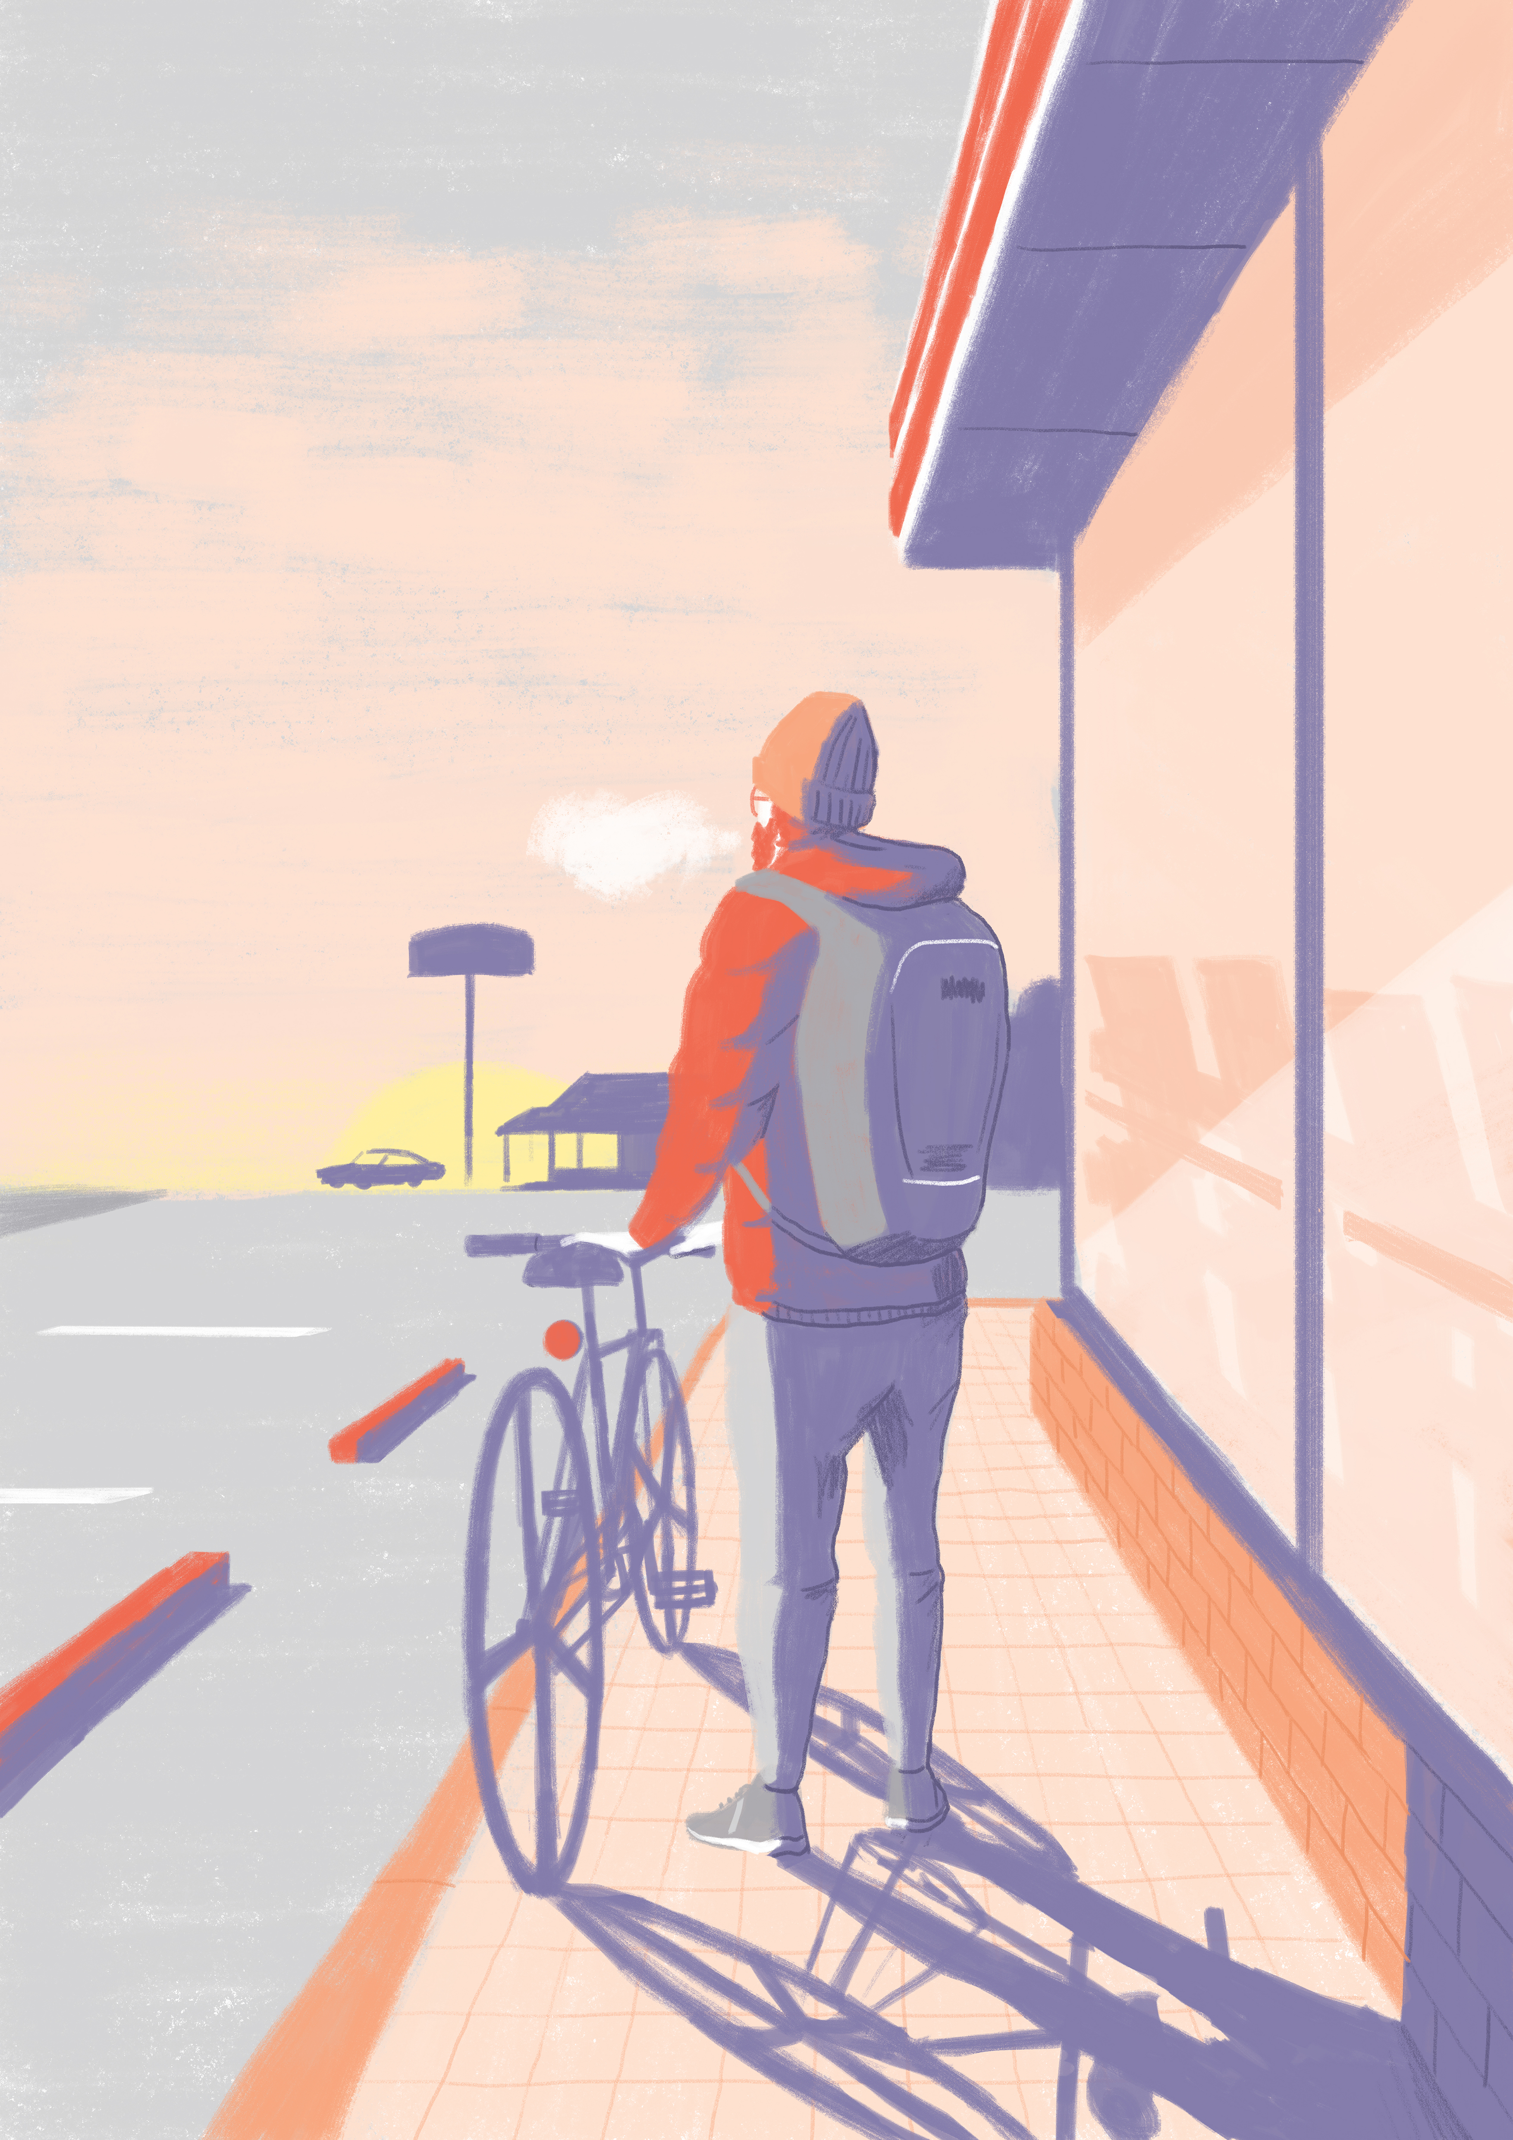
Problems
Question to Answer: How do annual members and casual riders use Cyclistic bikes differently?
Business Task: Identify differences between annual members and casual riders to create actionable insights which will be used to develop marketing strategies that will convince casual riders to become annual members.
Major Problem: Identifying differences between the two groups in the vast amount of data

Slide 6
Problems
Approach:
The data contains rides made by casual riders and annual members, particularly the date, time, and location of where each ride started and ended. It also contains what kind of bike was used.
From this data, I can generate characteristics of ride dates, ride times, ride locations, and bike type for both casual riders and annual members.
After generating this data, we can look at the differences between casual riders and annual members in how their behavior with bikes differs.

Slide 7
Problems
From the given fields within the data, differences between casual riders and annual members will be examined in the following areas:
Ride Length
Day of the Week
Season
Month
Bike Type
Ride Location
The results will then be compared to Cyclistic’s current offerings to see where the future marketing campaign could have the biggest impact.

Slide 8
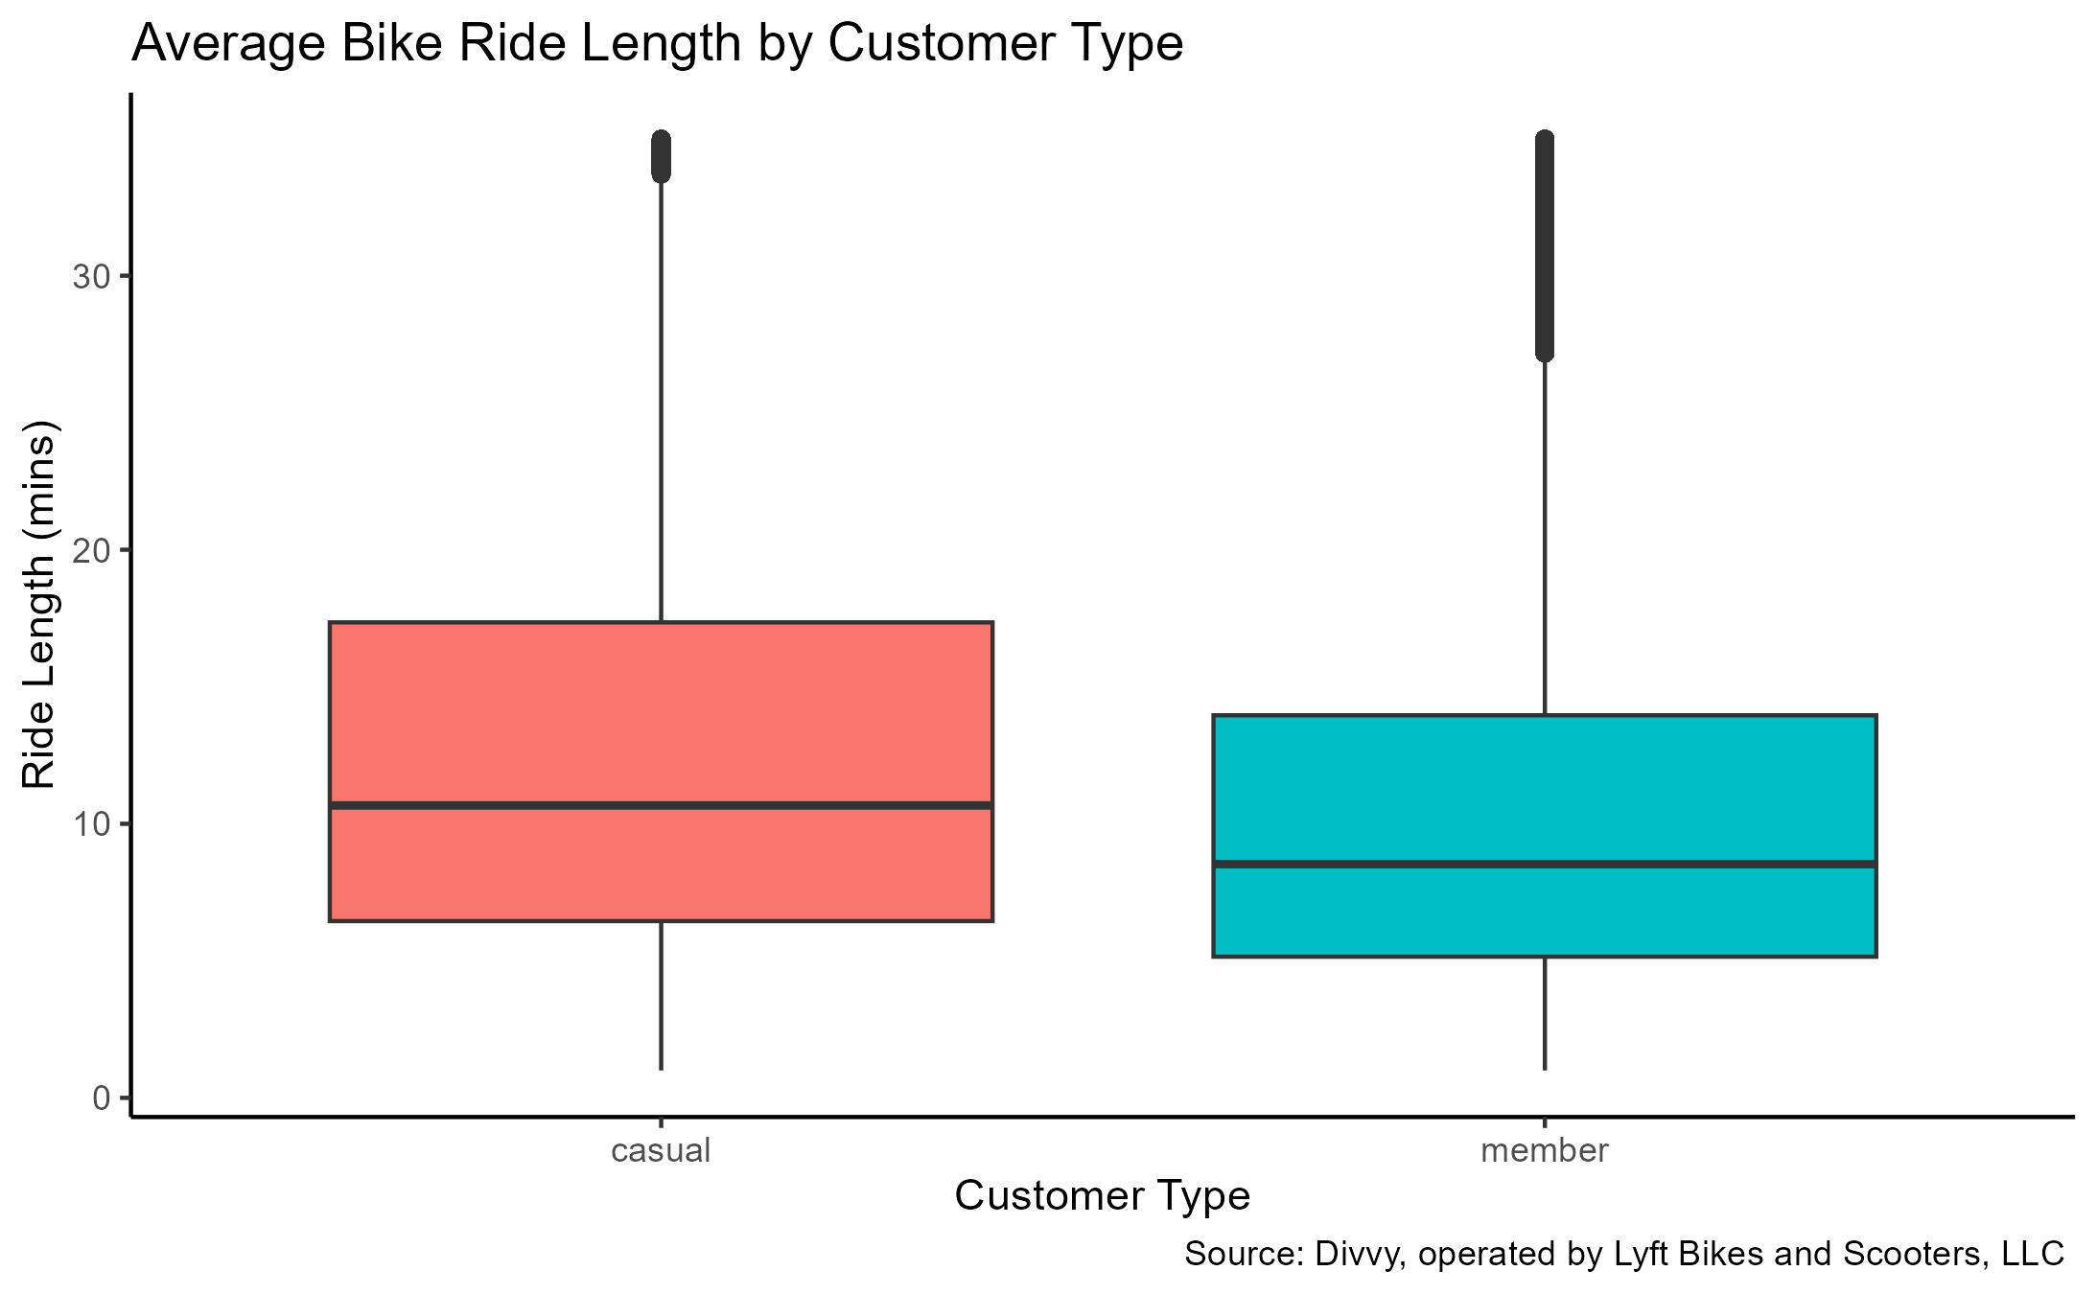
Problem 1 – ride length
Members have lower ride lengths for all three calculations: average, median, and mode ride lengths.
This means that
The average ride length of casual riders is longer.
The middle value of all casual ride lengths is higher.
The most common ride length for casual riders is higher.

Slide 9
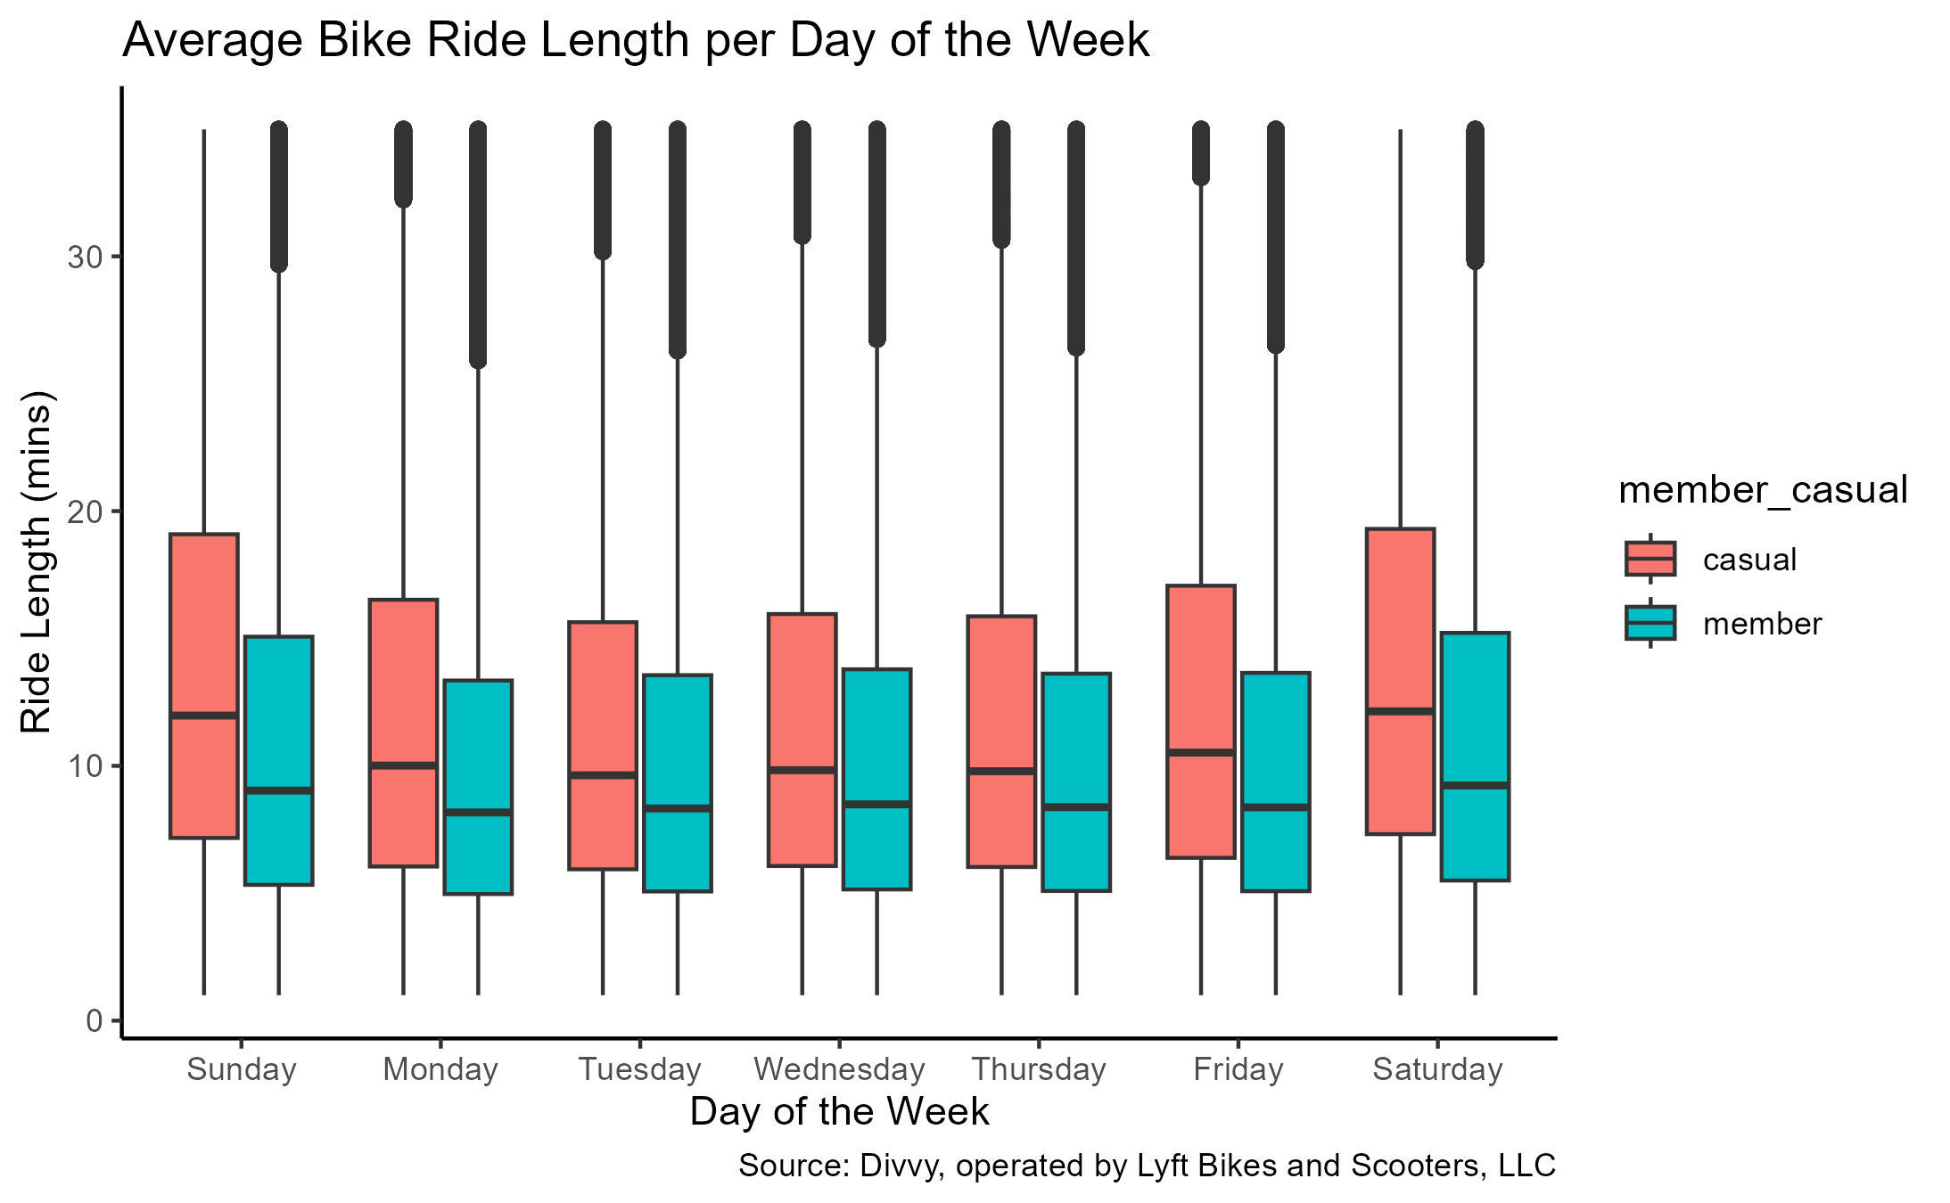
Problem 2 – day of the week
The average ride length per day is longest on Saturday for both casual and member riders.

Slide 10
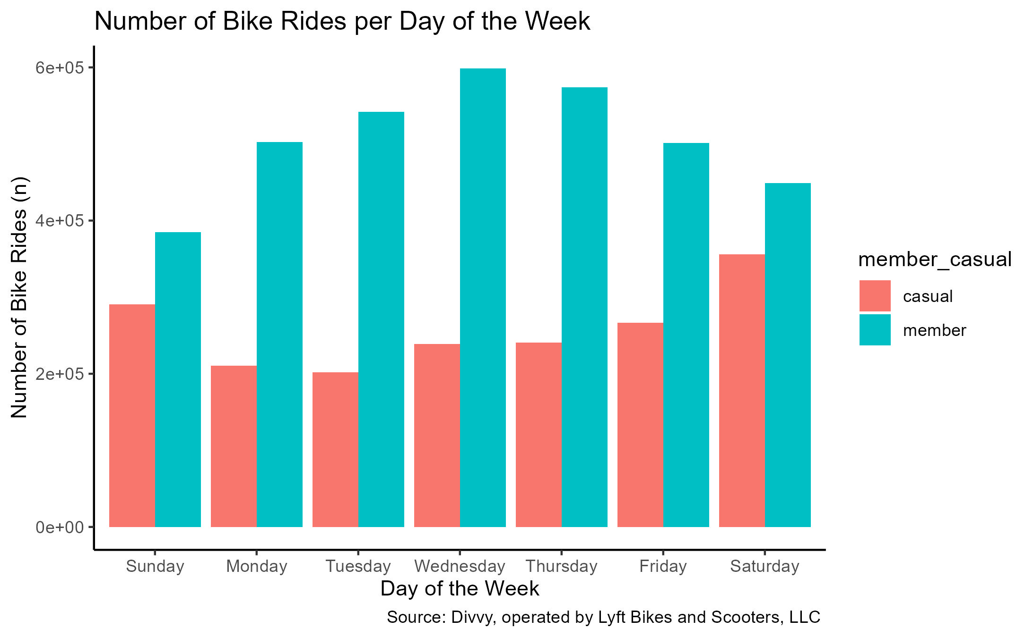
Problem 2 – day of the week
Casual riders ride mostly on Saturdays.
Member riders ride mostly on Wednesdays.

Slide 11
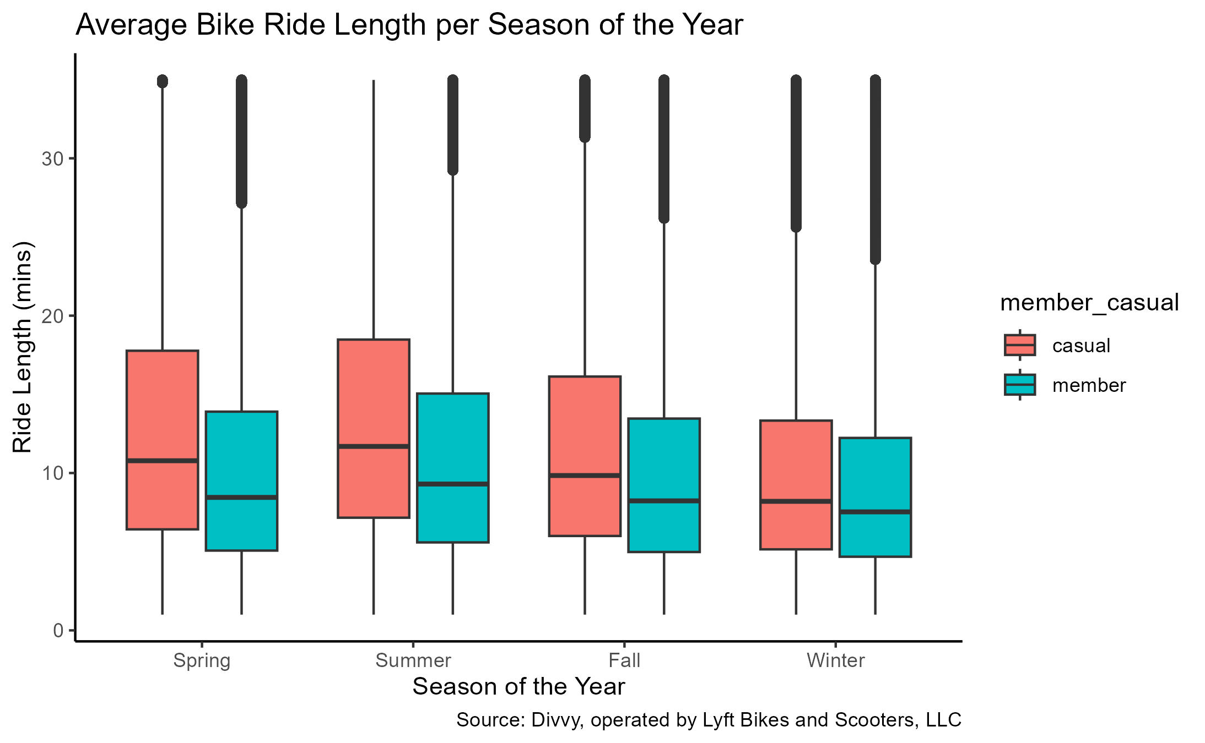
Problem 3 – Season of the year
The average ride length per season for both casual and member riders is longest in summer.
Note – these were the months chosen to represent each season:
Spring (Mar, Apr, May)
Summer (Jun, Jul, Aug)
Fall (Sep, Oct, Nov)
Winter (Dec, Jan, Feb)

Slide 12
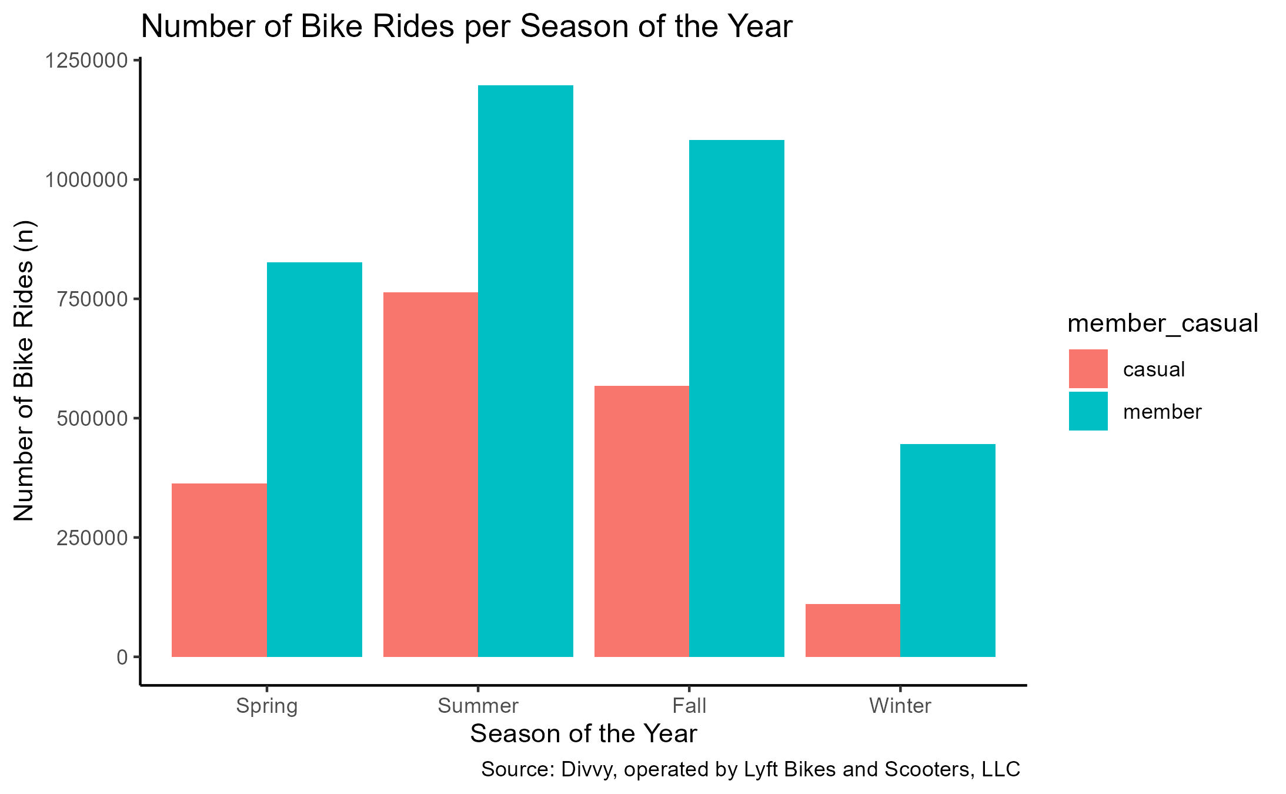
Problem 3 – Season of the year
Both casual and member riders ride mostly in summer.
Note – these were the months chosen to represent each season:
Spring (Mar, Apr, May)
Summer (Jun, Jul, Aug)
Fall (Sep, Oct, Nov)
Winter (Dec, Jan, Feb)

Slide 13
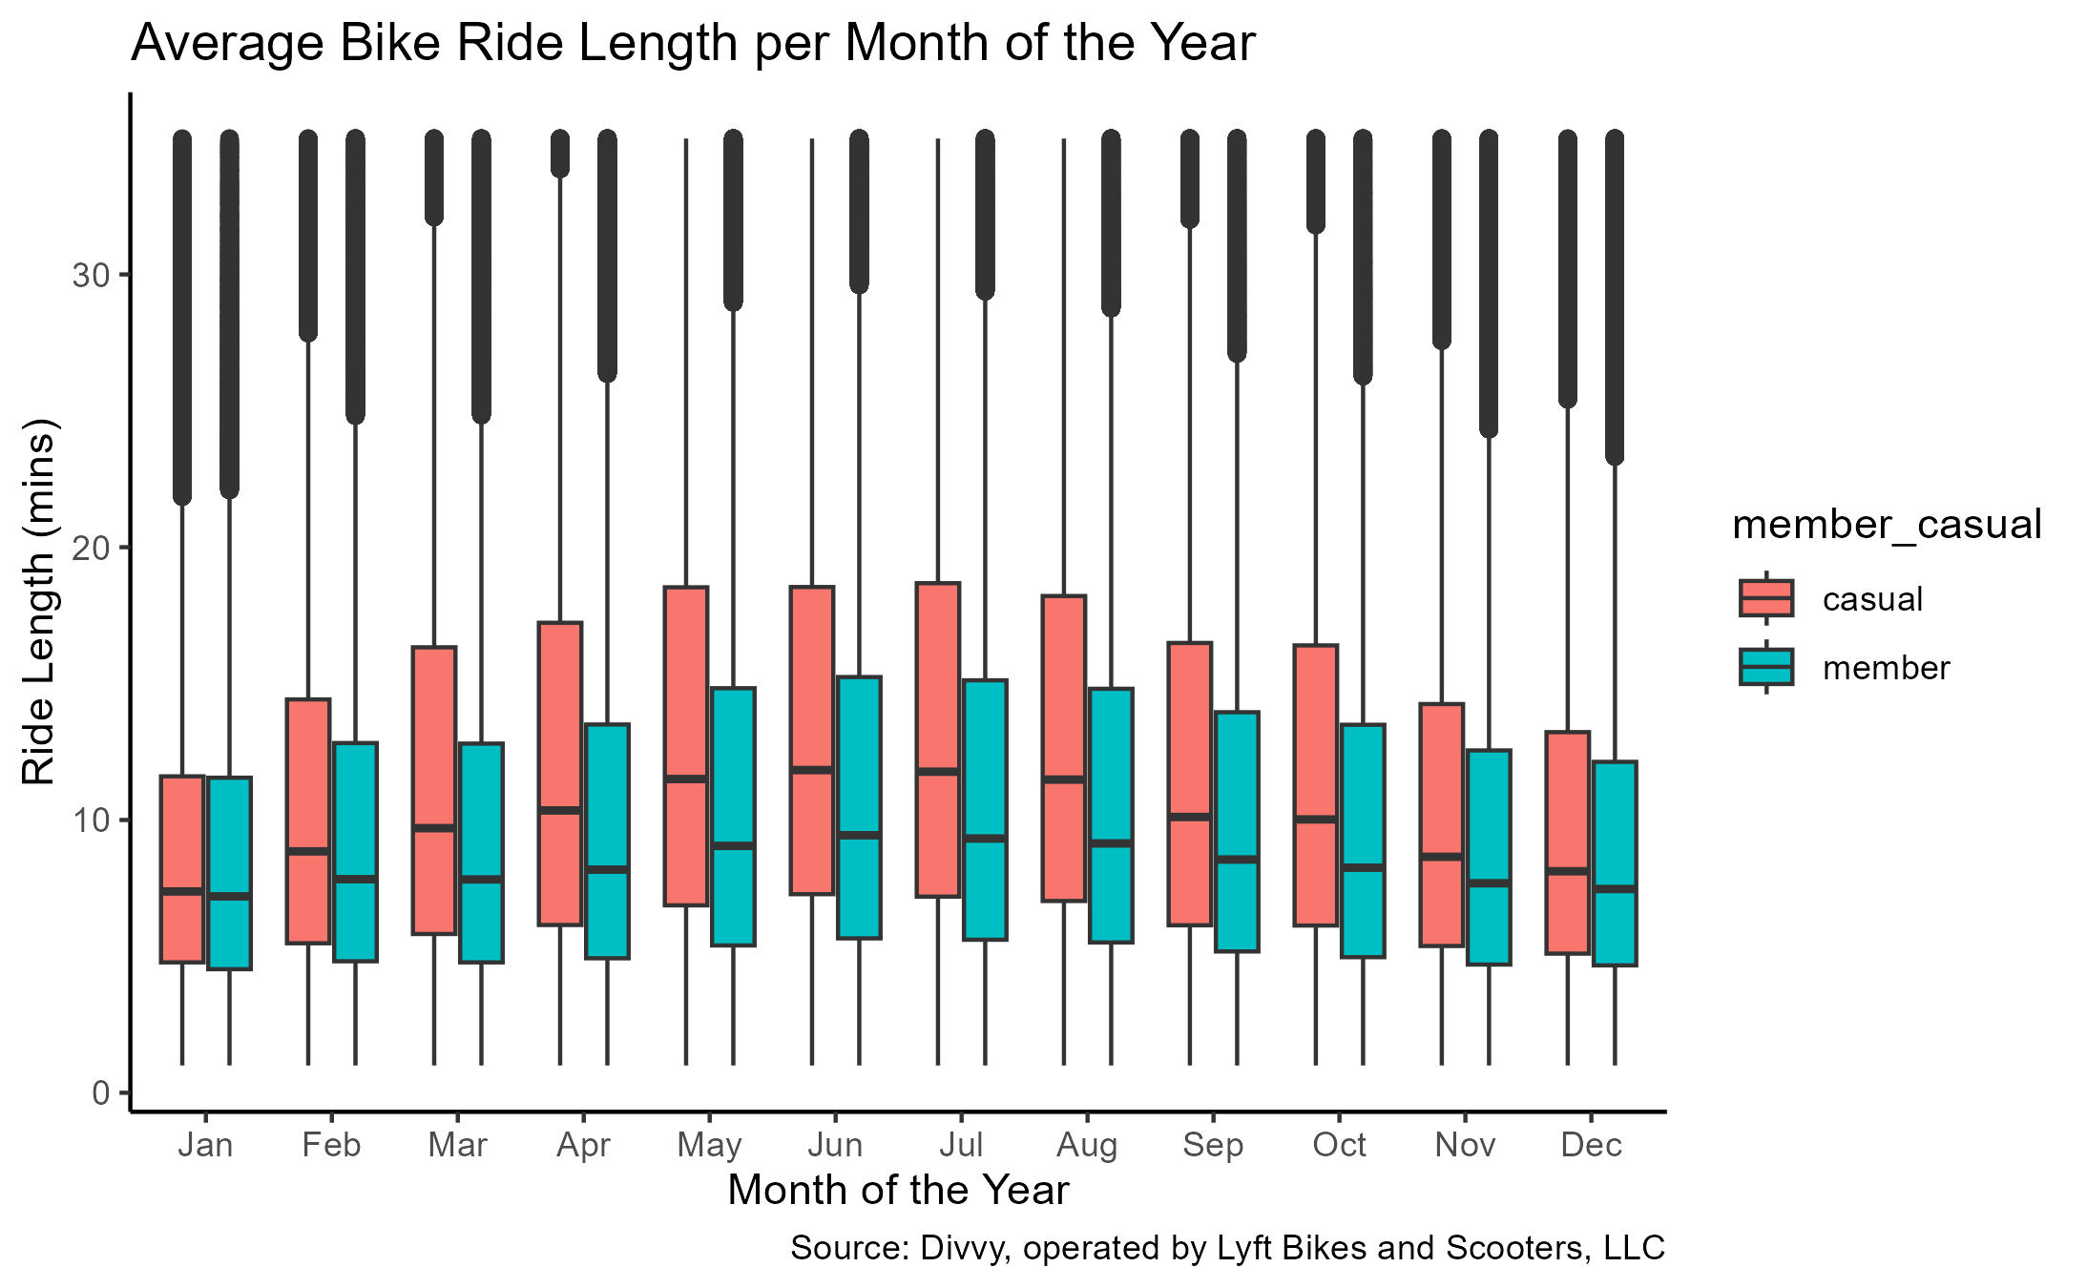
Problem 4 – Month of the year
Casual riders’ average ride length per month is longest in July.
Member riders’ average ride length per month is longest in June.

Slide 14
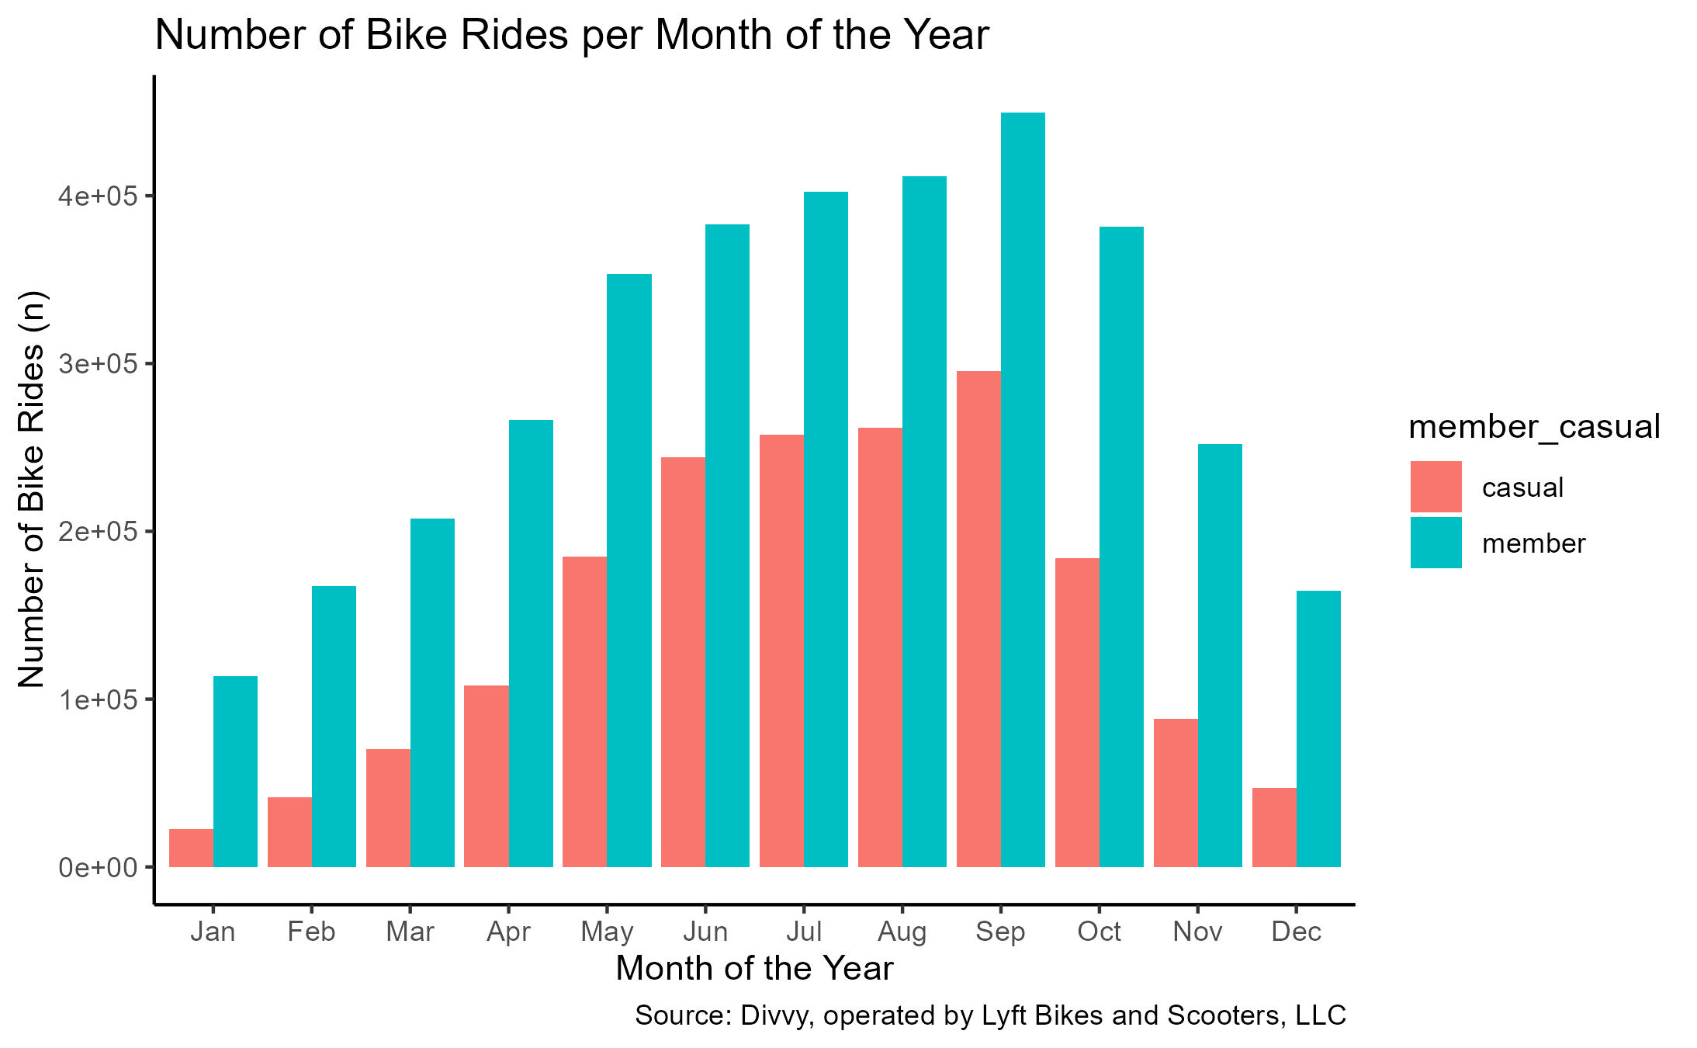
Problem 4 – Month of the year
Both casual riders and member riders ride mostly in September.

Slide 15
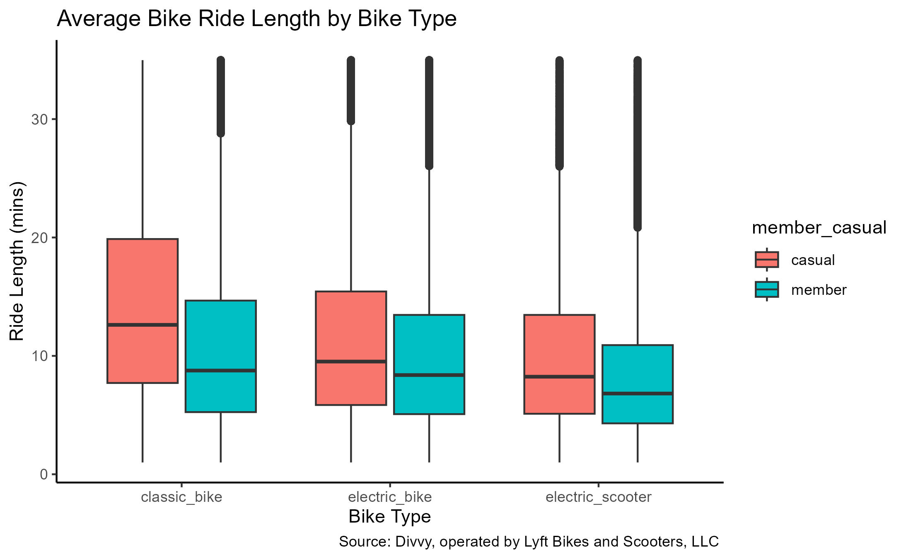
Problem 5 – Bike Type
Both casual and member riders have a higher average ride length with classic bikes over electric bikes and electric scooters.

Slide 16
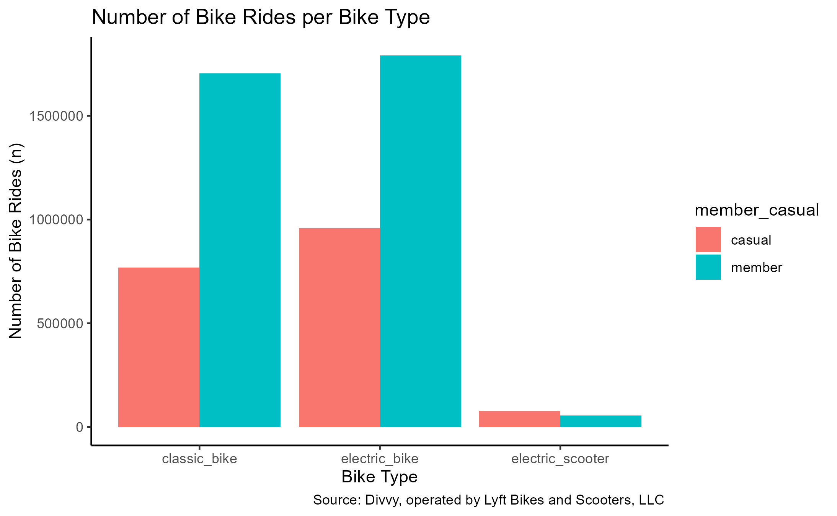
Problem 5 – Bike Type
Both casual and member riders ride more electric bikes than classic bikes or electric scooters.

Slide 17
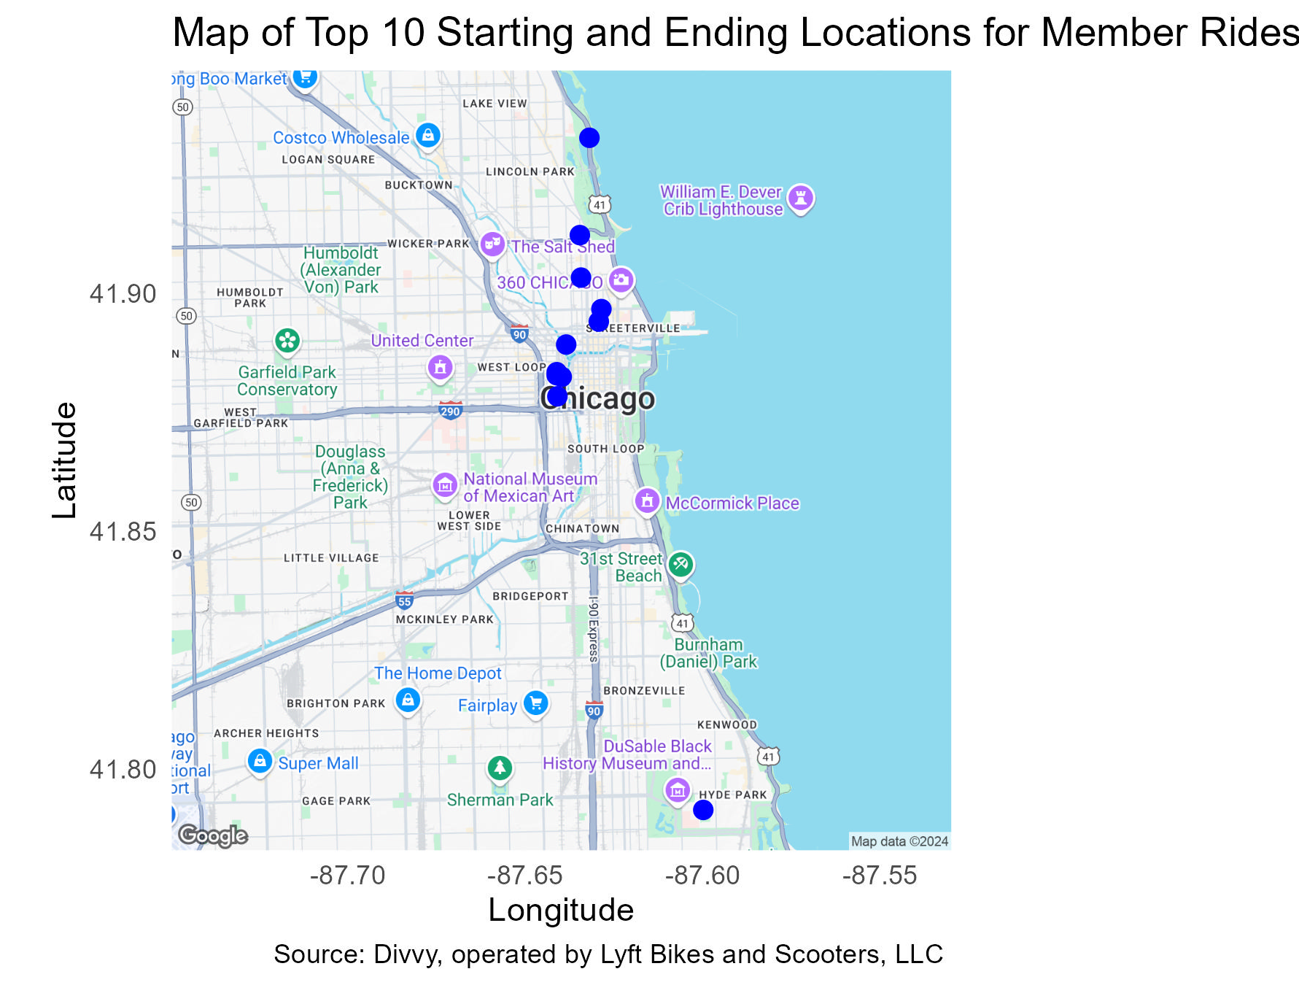
Problem 6 – ride locations (member)
Station Name | Start | End
Kingsbury St & Kinzie St | #1 | #1
Clinton St & Washington Blvd | #2 | #2
Clinton St & Madison St | #3 | #3
Clark St & Elm St | #4 | #4
Wells St & Concord Ln | #5 | #5
Wells St & Elm St | #6 | #6
Clinton St & Jackson Blvd | #7 | #7
State St & Chicago Ave | #8 | #8
University Ave & 57th St | #9 | #9
Clark St & Elm St | #10
Canal St & Madison St |  | #10
Top 10 locations are around popular commuting locations, universities, and attractions.

Slide 18
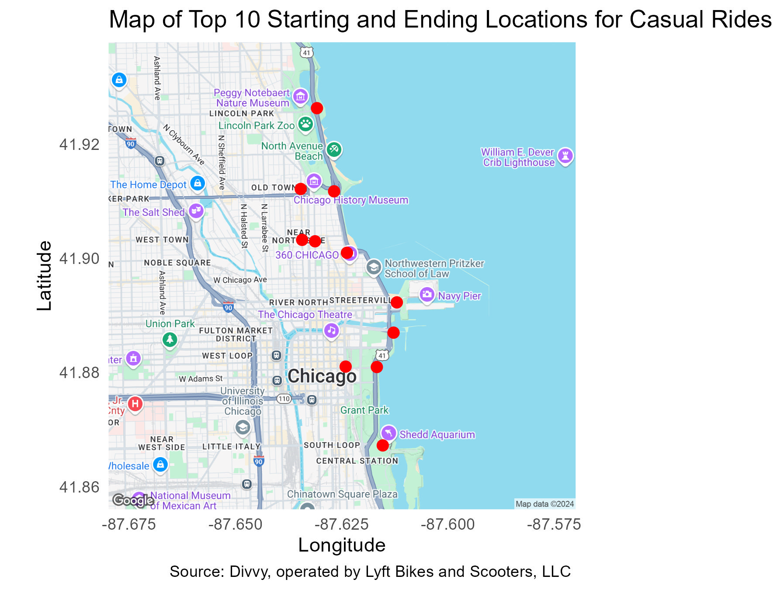
Problem 6 – ride locations (Casual)
Station Name | Start | End
Streeter Dr & Grand Ave | #1 | #1
DuSable Lake Shore Dr & North Blvd | #3 | #2
DuSable Lake Shore Dr & Monroe St | #2 | #3
Michigan Ave & Oak St | #4 | #4
Millennium Park | #6 | #5
Shedd Aquarium | #5 | #6
Theater on the Lake | #7 | #7
Dusable Harbor | #8 | #8
Wells St & Concord Ln | #9 | #9
Clark St & Elm St | #10
Wells St & Elm St |  | #10
Top 10 locations are around popular attractions.

Slide 19
Additional Problems

Slide 20
Current pass offerings
Cyclistic currently offers a variety of memberships. The current standings are as follows:
 | Casual |  | Member
 | Single Ride Pass | Day Pass $18.10/day | Year Pass $143.90/year
Classic Bike | $1 unlock + $0.18/min | 3 hours free per ride, then $0.18/min | 45 min free per ride, then $0.18/min
Electric Bike | $1 unlock + $0.44/min | Free unlocks + $0.44/min | Free unlocks + $0.18/min
Electric Scooter | $1 unlock + $0.44/min | Free unlocks + $0.44/min | Free unlocks + $0.29/min
Source: Divvy, operated by Lyft Bikes and Scooters, LLC.
Based on the findings of casual rider behavior, what would convince them to switch from a casual pass (single ride or day) to a member pass (year), i.e. at what point does an annual membership become a better value?
I will use the calculated average ride lengths to see at what point does a year pass become a better value compared to a single ride pass and compared to a day pass.
Analysis will only be performed only for electric bikes and classic bikes as they are the two primary ride types between both casual riders and member riders.

Slide 21
Comparison 1 – Single Ride Pass / Classic Bikes
Member riders take on average 10.5 min rides. The cost for their year pass using only classic bikes would remain $143.90 per year.
Casual riders take on average 12.66 min rides, which cost $3.28 per ride on a classic bike with the single ride pass.
If both casual riders and member riders took one ride each day for a year on a classic bike, the graph shows how their costs would vary.
Once a casual rider has taken their 44th 12.66 min ride on a classic bike, it would have been a better value to get the year pass.
Note: These comparisons were made on the basis of each customer taking one ride of average length per day, as there is no current available data on how many rides on average member riders and casual riders take per day.

Slide 22
Comparison 1 – Single Ride Pass / Electric Bikes
Member riders take on average 10.5 min rides. The cost for their year pass using only electric bikes would be $143.9 + $1.89 per ride.
Casual riders take on average 12.66 min rides, which cost $6.57 per ride on an electric bike with the single ride pass.
If both casual riders and member riders took one ride each day for a year on an electric bike, the graph shows how their costs would vary.
Once a casual rider has taken their 31st 12.66 min ride on an electric bike, it would have been a better value to get the year pass.
Note: These comparisons were made on the basis of each customer taking one ride of average length per day, as there is no current available data on how many rides on average member riders and casual riders take per day.

Slide 23
Comparison 2 – day pass / Classic Bikes
Member riders take on average 10.5 min rides. The cost for their year pass using only electric bikes would remain $143.90 per year.
Casual riders take on average 12.66 min rides. They could take any number of rides of that same length and the cost would still be $18.10 per day on a classic bike with the day pass.
If both casual riders and member riders took one ride each day for a year on a classic bike, the graph shows how their costs would vary.
Once a casual rider has bought their 8th day pass using an electric bike, it would have been a better value to get the year pass.
Note: These comparisons were made on the basis of each customer taking one ride of average length per day, as there is no current available data on how many rides on average member riders and casual riders take per day.

Slide 24
Comparison 2 – day pass / Electric Bikes
Member riders take on average 10.5 min rides. The cost for their year pass using only electric bikes would be $143.9 + $1.89 per ride.
Casual riders take on average 12.66 min rides, which cost $23.67 per ride on an electric bike with the day pass.
If both casual riders and member riders took one ride each day for a year on an electric bike, the graph shows how their costs would vary.
Once a casual rider has bought their 7th day pass using an electric bike, it would have been a better value to get the year pass.
Note: These comparisons were made on the basis of each customer taking one ride of average length per day, as there is no current available data on how many rides on average member riders and casual riders take per day.

Slide 25
Solutions

Slide 26
Solutions – overall Behavior findings
The findings of each problem were that casual riders differ from member riders in the following criteria:
 | Member Riders | Casual Riders
Ride Length | Member riders take shorter rides on average. | Casual riders take longer rides on average.
Day of the Week | Member riders ride more during the week, primarily Wednesday. But both take the longest rides on Saturday on average. | Casual riders ride more on the weekends, primarily Saturday. But both take the longest rides on Saturday on average.
Season | Both ride more often and ride longer on average during summer. Next most popular is fall.
Month | Both casual and member riders ride the most in September. But member riders ride longer on average in June. | Both casual and member riders ride the most in September. But casual riders ride longer on average in July.
Bike Type | Both ride more often and ride longer on average on electric bikes. The next most popular are classic bikes.
Ride Location | Member rides started and ended the most around 11 key locations around Chicago’s downtown as well but around popular commuting locations (like Union Station, the Ogilvie Transportation Center), universities (like Loyola University, the University of Chicago), and attractions (like the Chicago History Museum, the Diversey Driving Range). | Casual rides started and ended the most around 11 key locations around Chicago’s downtown, particularly around popular attractions like Millennium Park, the Shedd Aquarium, Navy Pier, the Lincoln Park Zoo, the Chicago History Museum, Willis Tower (formerly the Sears Tower), Theater on the Lake, the Art Institute, and the Modern Museum of Art.

Slide 27
Solutions – overall Behavior findings
Based on the behavior findings, casual riders may be tourists/visitors checking out Chicago (from out of state as well as people from surrounding suburbs).
Based on the behavior findings, member riders may be Chicago students, the weekday Chicago commuter, and Chicago tourists/visitors (from out of state as well as people from surrounding suburbs).

Slide 28
Solutions – overall pass comparison findings
The findings of each comparison were that the year pass becomes a better value after each of the following criteria:
 | Single Ride Pass (Casual) | Year Pass (Member)
Classic Bikes | If a casual rider is planning on taking 44 or more rides (at 12.66 min long on average) on a classic bike, | get the year pass!
Electric Bikes | If a casual rider is planning on taking 31 or more rides (at 12.66 min long on average) on an electric bike, | get the year pass!
 | Day Pass (Casual) | Year Pass (Member)
Classic Bikes | If a casual rider is planning on purchasing 8 or more day passes using a classic bike, | get the year pass!
Electric Bikes | If a casual rider is planning on purchasing 7 or more day passes using an electric bike, | get the year pass!
Note: These comparisons were made on the basis of each customer taking one ride of average length per day, as there is no current available data on how many rides on average member riders and casual riders take per day.

Slide 29
Solutions – overall pass comparison findings
Cyclistic currently offers perks and special memberships to entice casual riders to become members:
Perks for having a Year Pass: access to new features before anyone else, food tours, group rides, longer ride times, reserve-ahead features, and bike angels (taking bikes from crowded stations to empty stations to earn points toward ebike credits and free membership extensions)
University Membership: 21% off the year pass ($118.90 per year). Currently offered to 16 different colleges and universities in Chicago, including Loyola University and the University of Chicago.
Business Membership: 20% off the year pass ($115.12 per year, per sign up). Organization pays, employee pays nothing.
So Cyclistic is already offering options for casual riders to become member riders through a rider’s university or workplace.

Slide 30
Final Solutions
To encourage casual riders to become member riders, a new marketing campaign could be constructed to entice a switch. From the data findings between annual and casual members, the marketing campaign should focus on the following areas:
Maximizes longer rides
Maximizes weekend rides
Maximizes primarily summer rides, particularly June – September
Maximizes rides on electric and classic bikes
Maximizes rides starting and ending around the key 11 identified spots (popular Chicago attractions)

Slide 31
Final Solutions
Since Cyclistic already has plans that target students and businesses, the marketing campaign could also explore collaborating with tour packages, attraction packages, city explorer packages, and other tourist travel passes.
Another option would be to create a new type of pass. Since the current options go from single ride to single day to single year, the jump from a single ride/day to a single year could be too daunting for casual riders, regardless of the offered perks. Cyclistic could look into creating a weekend pass, a 3-4 day tourist pass, or even a summer month pass.

Slide 32
Conclusions

Slide 33
Conclusions
Behavior differences were found between casual riders and member riders.
Current pass offerings were evaluated to see where the value for the customer switches from a casual pass to a member pass.
Suggestions were made to create a new marketing campaign to entire casual riders to become member riders, based on the behavior findings and pass comparisons.
Suggestions were also made on new partnerships and new pass ideas.
Overall, I learned a great deal through this exercise. It gave me the opportunity to apply everything that I learned through the Google Data Analytics Professional Certificate. There was a lot gained by conducting this analysis through R. It was great to connect real data to a real-world scenario. It gave me experience in conducting my own analysis and reaching my own conclusions. A great project that I truly enjoyed working on and truly proud to complete!

Slide 34
Next steps

Slide 35
Next Steps
From the 3 proposed ideas (a new marketing campaign, attraction partnership/packages, new pass varieties), I propose that we go with the new marketing campaign.
This option is the lowest risk investment, with attraction partnership/packages being labor and legal intensive and new pass varieties being possible threats to the passes already established.
It will give the company publicity.
It will provide the public more information on what Cyclistic offers, hopefully making our options clearer.
The marketing campaign should be headed by the marketing department, possibly partnering with any outreach teams. Since this analysis was conducted in November, there is ample time to prepare and polish a solid marketing campaign at the start of summer next year. Planning should start now to have proposals ready for evaluation by March.

Slide 36
Next Steps
While I was able to find differences in behavior and in passes, there is still more that can be done.
We could look at multiple ride behaviors:
how many single ride passes a single casual rider takes in a single day
how many rides a casual rider takes on a single day pass
how many rides a single casual rider and a single member rider takes within a single year
Gathering and examining this data would allow us to further understand the behaviors between casual riders and member riders. It would also allow us to further examine where the gaps in pass offerings would be.

Slide 37
Next Steps
While I was able to find some differences in behavior and in passes, there is still more that can be done.
We could take a look at various member rider/year pass holder behaviors:
how many member riders have the business membership
how many member riders have the university membership
Gathering and examining this data would allow us to further understand the behaviors of non-student, non-business member riders. We could find out more about member riders to find further differences between them and casual riders.

Slide 38
Thank you
Dana Anderson
dana.k.anderson88@gmail.com

Slide 39
Additional Information

Slide 40
Solution 1 – ride length
Rider Type | Minimum Ride Length (mins) | Maximum Ride Length (mins) | Average Ride Length (mins) | Median Ride Length (mins) | Mode Ride Length (mins) | 25th Quantile Ride Length (mins) | 75th Quantile Ride Length (mins) | IQR Ride Length (mins) | Standard Deviation Ride Length (mins) | Variance Ride Length (mins)
member | 1 | 34.98 | 10.5 | 8.53 | 4.92 | 5.15 | 13.96 | 8.81 | 7.11 | 50.52
casual | 1 | 34.98 | 12.66 | 10.67 | 6.3 | 6.45 | 17.35 | 10.9 | 7.92 | 62.78
There were a total of 5,357,670 records evaluated. 1,805,459 were casual. 3,552,211 were members.
Members have lower ride lengths for all three calculations: average, median, and mode ride lengths.
This means that
The average ride length of casual riders is longer.
The middle value of all casual ride lengths is higher.
The most common ride length for casual riders is higher.

Slide 41

Solution 2 – day of the week
 | Members |  | Casual
Day of the Week (Trip Start) | Average Ride Length (mins) | Number of Rides (n) | Average Ride Length (mins) | Number of Rides (n)
Sunday | 11.12 | 385,137 | 13.75 | 290,500
Monday | 10.14 | 502,825 | 12.13 | 210,848
Tuesday | 10.26 | 541,674 | 11.66 | 202,113
Wednesday | 10.4 | 598,504 | 11.86 | 238,748
Thursday | 10.28 | 574,124 | 11.81 | 240,810
Friday | 10.31 | 501,160 | 12.52 | 266,538
Saturday | 11.25 | 448,787 | 13.89 | 355,902
Overall | 10.5 | 3,552,211 | 12.66 | 1,805,459
Casual riders ride mostly on Saturdays. Their average ride length per day is longest on Saturdays.
Member riders ride mostly on Wednesdays. Their average ride length per day is longest on Saturdays.
Top hats represent the ‘top’ values!

Slide 42
Solution 2 – day of the week (MEmber)
Day of the Week (Member) | Minimum Ride Length (mins) | Maximum Ride Length (mins) | Average Ride Length (mins) | Median Ride Length (mins) | Mode Ride Length (mins) | 25th Quantile Ride Length (mins) | 75th Quantile Ride Length (mins) | IQR Ride Length (mins) | Standard Deviation Ride Length (mins) | Variance Ride Length (mins)
Sunday | 1 | 34.98 | 11.12 | 9.03 | 4.85 | 5.33 | 15.07 | 9.74 | 7.52 | 56.62
Monday | 1 | 34.98 | 10.14 | 8.17 | 4.92 | 4.97 | 13.35 | 8.38 | 6.95 | 48.32
Tuesday | 1 | 34.98 | 10.26 | 8.33 | 4.17 | 5.07 | 13.56 | 8.49 | 6.96 | 48.48
Wednesday | 1 | 34.98 | 10.4 | 8.49 | 5.07 | 5.15 | 13.79 | 8.64 | 7 | 49.06
Thursday | 1 | 34.98 | 10.28 | 8.38 | 4.68 | 5.09 | 13.62 | 8.53 | 6.93 | 48.04
Friday | 1 | 34.98 | 10.31 | 8.37 | 4.75 | 5.08 | 13.65 | 8.57 | 7 | 48.96
Saturday | 1 | 34.98 | 11.25 | 9.23 | 4.58 | 5.5 | 15.22 | 9.72 | 7.48 | 55.9

Slide 43
Solution 2 – day of the week (CASUAL)
Day of the Week (Casual) | Minimum Ride Length (mins) | Maximum Ride Length (mins) | Average Ride Length (mins) | Median Ride Length (mins) | Mode Ride Length (mins) | 25th Quantile Ride Length (mins) | 75th Quantile Ride Length (mins) | IQR Ride Length (mins) | Standard Deviation Ride Length (mins) | Variance Ride Length (mins)
Sunday | 1 | 34.98 | 13.75 | 11.975 | 7.78 | 7.17 | 19.09 | 11.92 | 8.24 | 67.84
Monday | 1 | 34.98 | 12.13 | 10.01 | 5.33 | 6.05 | 16.52 | 10.47 | 7.82 | 61.17
Tuesday | 1 | 34.98 | 11.66 | 9.63 | 5.02 | 5.94 | 15.64 | 9.7 | 7.49 | 56.06
Wednesday | 1 | 34.98 | 11.86 | 9.83 | 4.93 | 6.07 | 15.96 | 9.89 | 7.55 | 56.94
Thursday | 1 | 34.98 | 11.81 | 9.79 | 5.75 | 6.03 | 15.87 | 9.84 | 7.55 | 56.93
Friday | 1 | 34.98 | 12.52 | 10.52 | 6.4 | 6.39 | 17.07 | 10.68 | 7.86 | 61.82
Saturday | 1 | 34.98 | 13.89 | 12.14 | 7.77 | 7.32 | 19.3 | 11.98 | 8.24 | 67.87

Slide 44
Solution 3 – Season of the Year
 | Members |  | Casual
Season of the Year | Average Ride Length (mins) | Number of Rides (n) | Average Ride Length (mins) | Number of Rides (n)
Spring (Mar, Apr, May) | 10.45 | 826,969 | 12.83 | 363,368
Summer (Jun, Jul, Aug) | 11.21 | 1,197,056 | 13.48 | 763,139
Fall (Sep, Oct, Nov) | 10.18 | 1,082,923 | 11.92 | 567,795
Winter (Dec, Jan, Feb) | 9.43 | 445,263 | 10.28 | 111,157
Overall | 10.5 | 3,552,211 | 12.66 | 1,805,459
Both casual and member riders ride mostly in summer.
The average ride length per season for both casual and member riders is longest in summer.
Top hats represent the ‘top’ values!

Slide 45
Solution 3 – Season of the Year (member)
Season of the Year | Minimum Ride Length (mins) | Maximum Ride Length (mins) | Average Ride Length (mins) | Median Ride Length (mins) | Mode Ride Length (mins) | 25th Quantile Ride Length (mins) | 75th Quantile Ride Length (mins) | IQR Ride Length (mins) | Standard Deviation Ride Length (mins) | Variance Ride Length (mins)
Spring | 1 | 34.98 | 10.45 | 8.45 | 4.53 | 5.07 | 13.9 | 8.83 | 7.16 | 5.07
Summer | 1 | 34.98 | 11.21 | 9.3 | 5.67 | 5.59 | 15.05 | 9.46 | 7.34 | 5.59
Fall | 1 | 34.98 | 10.18 | 8.23 | 4.92 | 4.98 | 13.46 | 8.48 | 6.94 | 4.98
Winter | 1 | 34.98 | 9.43 | 7.53 | 4.65 | 4.68 | 12.23 | 7.55 | 6.57 | 4.68

Slide 46
Solution 3 – Season of the Year (Casual)
Season of the Year | Minimum Ride Length (mins) | Maximum Ride Length (mins) | Average Ride Length (mins) | Median Ride Length (mins) | Mode Ride Length (mins) | 25th Quantile Ride Length (mins) | 75th Quantile Ride Length (mins) | IQR Ride Length (mins) | Standard Deviation Ride Length (mins) | Variance Ride Length (mins)
Spring | 1 | 34.98 | 12.83 | 10.78 | 5.52 | 6.42 | 17.77 | 11.35 | 8.1 | 6.42
Summer | 1 | 34.98 | 13.48 | 11.69 | 6.95 | 7.16 | 18.48 | 11.32 | 8.02 | 7.16
Fall | 1 | 34.98 | 11.92 | 9.84 | 6.3 | 6 | 16.13 | 10.13 | 7.69 | 6
Winter | 1 | 34.98 | 10.28 | 8.2 | 4.7 | 5.15 | 13.33 | 8.18 | 7 | 5.15

Slide 47
Solution 4 – Month of the Year
 | Members |  | Casual
Month of the Year (Trip Start) | Average Ride Length (mins) | Number of Rides (n) | Average Ride Length (mins) | Number of Rides (n)
Jan | 9.02 | 113,666 | 9.23 | 22,478
Feb | 9.8 | 167,207 | 10.98 | 41,409
Mar | 9.79 | 207,534 | 11.93 | 70,235
Apr | 10.2 | 266,300 | 12.48 | 108,277
May | 11.03 | 353,135 | 13.38 | 184,856
Jun | 11.34 | 383,128 | 13.55 | 244,131
Jul | 11.25 | 402,403 | 13.58 | 257,447
Aug | 11.05 | 411,525 | 13.31 | 261,561
Sep | 10.49 | 449,449 | 12.13 | 295,363
Oct | 10.19 | 381,618 | 12.13 | 184,041
Nov | 9.6 | 251,856 | 10.79 | 88,391
Dec | 9.35 | 164,390 | 10.17 | 47,270
Overall | 10.5 | 3,552,211 | 12.66 | 1,805,459
Casual riders’ average ride length per month is longest in July. Member riders’ average ride length per month is longest in June.
Both casual riders and member riders ride mostly in September.
Top hats represent the ‘top’ values!

Slide 48
Solution 4 – Month of the Year (MEmber)
Month of the Year (Member) | Minimum Ride Length (mins) | Maximum Ride Length (mins) | Average Ride Length (mins) | Median Ride Length (mins) | Mode Ride Length (mins) | 25th Quantile Ride Length (mins) | 75th Quantile Ride Length (mins) | IQR Ride Length (mins) | Standard Deviation Ride Length (mins) | Variance Ride Length (mins)
Jan | 1 | 34.98 | 9.02 | 7.2 | 5.07 | 4.53 | 11.55 | 7.02 | 6.31 | 39.88
Feb | 1 | 34.98 | 9.8 | 7.83 | 4.25 | 4.82 | 12.82 | 8 | 6.79 | 46.13
Mar | 1 | 34.98 | 9.79 | 7.82 | 5 | 4.78 | 12.8 | 8.02 | 6.83 | 46.68
Apr | 1 | 34.98 | 10.2 | 8.18 | 3.57 | 4.93 | 13.5 | 8.57 | 7.06 | 49.87
May | 1 | 34.98 | 11.03 | 9.05 | 4.5 | 5.4 | 14.83 | 9.43 | 7.38 | 54.42
Jun | 1 | 34.98 | 11.34 | 9.44 | 5.32 | 5.66 | 15.24 | 9.58 | 7.38 | 54.44
Jul | 1 | 34.98 | 11.25 | 9.32 | 6.35 | 5.61 | 15.12 | 9.51 | 7.37 | 54.33
Aug | 1 | 34.98 | 11.05 | 9.14 | 5.58 | 5.51 | 14.81 | 9.3 | 7.27 | 52.86
Sep | 1 | 34.98 | 10.49 | 8.55 | 4.66 | 5.18 | 13.95 | 8.77 | 7.04 | 49.58
Oct | 1 | 34.98 | 10.19 | 8.25 | 4.45 | 4.97 | 13.49 | 8.52 | 6.96 | 48.44
Nov | 1 | 34.98 | 9.6 | 7.68 | 4 | 4.7 | 12.55 | 7.85 | 6.68 | 44.62
Dec | 1 | 34.98 | 9.35 | 7.47 | 4.6 | 4.67 | 12.13 | 7.46 | 6.49 | 42.13

Slide 49
Solution 4 – Month of the Year (CASUAL)
Month of the Year (Casual) | Minimum Ride Length (mins) | Maximum Ride Length (mins) | Average Ride Length (mins) | Median Ride Length (mins) | Mode Ride Length (mins) | 25th Quantile Ride Length (mins) | 75th Quantile Ride Length (mins) | IQR Ride Length (mins) | Standard Deviation Ride Length (mins) | Variance Ride Length (mins)
Jan | 1 | 34.98 | 9.23 | 7.38 | 4.92 | 4.78 | 11.6 | 6.82 | 6.35 | 40.29
Feb | 1 | 34.98 | 10.98 | 8.85 | 6.38 | 5.48 | 14.42 | 8.94 | 7.34 | 53.91
Mar | 1 | 34.98 | 11.93 | 9.7 | 5.7 | 5.82 | 16.33 | 10.51 | 7.87 | 61.95
Apr | 1 | 34.98 | 12.48 | 10.35 | 4.85 | 6.15 | 17.23 | 11.08 | 8.05 | 64.81
May | 1 | 34.98 | 13.38 | 11.5 | 6.37 | 6.87 | 18.53 | 11.66 | 8.17 | 66.7
Jun | 1 | 34.98 | 13.55 | 11.83 | 7.34 | 7.28 | 18.54 | 11.26 | 7.97 | 63.47
Jul | 1 | 34.98 | 13.58 | 11.77 | 8.13 | 7.19 | 18.68 | 11.49 | 8.09 | 65.43
Aug | 1 | 34.98 | 13.31 | 11.48 | 7.58 | 7.03 | 18.21 | 11.18 | 7.99 | 63.84
Sep | 1 | 34.98 | 12.13 | 10.11 | 5.39 | 6.14 | 16.49 | 10.35 | 7.74 | 59.85
Oct | 1 | 34.98 | 12.13 | 10.02 | 5.59 | 6.13 | 16.4 | 10.27 | 7.77 | 60.34
Nov | 1 | 34.98 | 10.79 | 8.65 | 4.12 | 5.38 | 14.25 | 8.87 | 7.25 | 52.58
Dec | 1 | 34.98 | 10.17 | 8.12 | 4.93 | 5.1 | 13.22 | 8.12 | 6.93 | 47.98

Slide 50
Solution 5 – Bike type
 | Members |  | Casual
Bike Type | Average Ride Length (mins) | Number of Rides (n) | Average Ride Length (mins) | Number of Rides (n)
Classic Bike | 10.94 | 1,705,183 | 14.34 | 768,792
Electric Bike | 10.13 | 1,791,264 | 11.51 | 959,042
Electric Scooter | 8.38 | 55,764 | 10.26 | 77,625
Overall | 10.5 | 3,552,211 | 12.66 | 1,805,459
Both casual and member riders ride more electric bikes than classic bikes or electric scooters.
Both casual and member riders have a higher average ride length with classic bikes over electric bikes and electric scooters.
Top hats represent the ‘top’ values!

Slide 51
Solution 5 – bike type (member)
Bike Type | Minimum Ride Length (mins) | Maximum Ride Length (mins) | Average Ride Length (mins) | Median Ride Length (mins) | Mode Ride Length (mins) | 25th Quantile Ride Length (mins) | 75th Quantile Ride Length (mins) | IQR Ride Length (mins) | Standard Deviation Ride Length (mins) | Variance Ride Length (mins)
Classic Bike | 1 | 34.98 | 10.94 | 8.76 | 4.92 | 5.25 | 14.67 | 9.42 | 7.52 | 56.58
Electric Bike | 1 | 34.98 | 10.13 | 8.38 | 4.1 | 5.08 | 13.46 | 8.38 | 6.7 | 44.88
Electric Scooter | 1 | 34.98 | 8.38 | 6.82 | 3.57 | 4.3 | 10.91 | 6.61 | 5.66 | 32.03

Slide 52
Solution 5 – bike type (Casual)
Bike Type | Minimum Ride Length (mins) | Maximum Ride Length (mins) | Average Ride Length (mins) | Median Ride Length (mins) | Mode Ride Length (mins) | 25th Quantile Ride Length (mins) | 75th Quantile Ride Length (mins) | IQR Ride Length (mins) | Standard Deviation Ride Length (mins) | Variance Ride Length (mins)
Classic Bike | 1 | 34.98 | 14.34 | 12.62 | 7.6 | 7.71 | 19.87 | 12.16 | 8.28 | 68.58
Electric Bike | 1 | 34.98 | 11.51 | 9.52 | 6.4 | 5.85 | 15.44 | 9.59 | 7.43 | 55.2
Electric Scooter | 1 | 34.98 | 10.26 | 8.24 | 6.06 | 5.11 | 13.46 | 8.35 | 7.01 | 49.08

Slide 53
Solution 6 – Top 10 Start Stations (member)
# | Station Name | Number of Rides (n) | Latitude | Longitude
1 | Kingsbury St & Kinzie St | 28,688 | 41.8892 | -87.639
2 | Clinton St & Washington Blvd | 27,568 | 41.8834 | -87.641
3 | Clinton St & Madison St | 24,205 | 41.8828 | -87.641
4 | Clark St & Elm St | 23,837 | 41.9325 | -87.632
5 | Wells St & Concord Ln | 20,424 | 41.9121 | -87.635
6 | Wells St & Elm St | 20,003 | 41.9032 | -87.634
7 | Clinton St & Jackson Blvd | 19,469 | 41.8783 | -87.641
8 | State St & Chicago Ave | 18,531 | 41.8966 | -87.629
9 | University Ave & 57th St | 18,218 | 41.7915 | -87.6
10 | Dearborn St & Erie St | 17,945 | 41.894 | -87.629
Note: There were 617,476 member rides without start station names. This accounted for 0.1738 (17.38%) of all casual data and 0.1153 (11.53%) of the final data set.

Slide 54
Solution 6 – Top 10 end Stations (member)
# | Station Name | Number of Rides (n) | Latitude | Longitude
1 | Kingsbury St & Kinzie St | 28,886 | 41.8892 | -87.639
2 | Clinton St & Washington Blvd | 28,592 | 41.8834 | -87.641
3 | Clinton St & Madison St | 25,605 | 41.8828 | -87.641
4 | Clark St & Elm St | 24,072 | 41.9325 | -87.632
5 | Wells St & Concord Ln | 20,627 | 41.9121 | -87.635
6 | Wells St & Elm St | 19,955 | 41.9032 | -87.634
7 | Clinton St & Jackson Blvd | 19,876 | 41.8783 | -87.641
8 | State St & Chicago Ave | 19,265 | 41.8966 | -87.629
9 | University Ave & 57th St | 18,653 | 41.7915 | -87.6
10 | Canal St & Madison St | 17,961 | 41.8824 | -87.64
Note: There were 593,251 member rides without end station names. This accounted for 0.1670 (16.70%) of all casual data and 0.1107 (11.07%) of the final data set.

Slide 55
Solution 6 – Top 10 Start Stations (Casual)
# | Station Name | Number of Rides (n) | Latitude | Longitude
1 | Streeter Dr & Grand Ave | 33,370 | 41.892 | -87.612
2 | DuSable Lake Shore Dr & Monroe St | 22,197 | 41.881 | -87.617
3 | DuSable Lake Shore Dr & North Blvd | 18,071 | 41.912 | -87.627
4 | Michigan Ave & Oak St | 16,198 | 41.901 | -87.624
5 | Shedd Aquarium | 15,707 | 41.867 | -87.615
6 | Millennium Park | 14,618 | 41.881 | -87.624
7 | Theater on the Lake | 12,856 | 41.926 | -87.631
8 | Dusable Harbor | 12,624 | 41.887 | -87.613
9 | Wells St & Concord Ln | 10,464 | 41.912 | -87.635
10 | Clark St & Elm St | 9,844 | 41.903 | -87.631
Note: There were 352,648 casual rides without start station names. This accounted for 0.1953 (19.53%) of all casual data and 0.0658 (6.58%) of the final data set.

Slide 56
Solution 6 – Top 10 End Stations (Casual)
# | Station Name | Number of Rides (n) | Latitude | Longitude
1 | Streeter Dr & Grand Ave | 35,330 | 41.892 | -87.612
2 | DuSable Lake Shore Dr & North Blvd | 20,292 | 41.912 | -87.627
3 | DuSable Lake Shore Dr & Monroe St | 19,819 | 41.881 | -87.617
4 | Michigan Ave & Oak St | 16,691 | 41.901 | -87.624
5 | Millennium Park | 16,427 | 41.881 | -87.624
6 | Shedd Aquarium | 14,136 | 41.867 | -87.615
7 | Theater on the Lake | 12,674 | 41.926 | -87.631
8 | Dusable Harbor | 11,020 | 41.887 | -87.613
9 | Wells St & Concord Ln | 10,415 | 41.912 | -87.635
10 | Wells St & Elm St | 9,578 | 41.903 | -87.634
Note: There were 376,423 casual rides without end station names. This accounted for 0.2085 (20.85%) of all casual data and 0.0703 (7.03%) of the final data set.

Slide 57
Appendices

Slide 58
The Data
Cyclistic's data was housed by the cloud computing platform, Amazon Web Services (AWS), located at the following address (https://divvy-tripdata.s3.amazonaws.com/index.html).
The datasets of the most recent 12 months (November 2023 - October 2024) were downloaded and stored.
The data was
R: Reliable. The data contained large, complete amounts of data for each month. The data was also unbiased as it contained no customer information, only ride information.
O: Original. The first party data came from the bike sharing system, Divvy, which is a program of the Chicago Department of Transportation (CDOT) and operated by Lyft Bikes and Scooters, LLC (“Bikeshare”).
C: Comprehensive. The data contained all information needed to compare member riders and casual riders, based on rides alone.
C: Current. The most recent 12 months of data were gathered for this analysis.
C: Cited. The data was vetted by being first party data, gathered from a clearly identifiable source. In order to get further proof of the data being vetted, I contacted the data team at Lyft myself to see if there were any additional information. Their support representative stated, “Our internal teams and external partners review and verify the published data to ensure accurate and correct reporting.”

Slide 59
The Data
Licensing – The data was allowed to be analyzed through a license, located at the following address (https://divvybikes.com/data-license-agreement).
Privacy and Security – The data contained zero personal information and zero financial information related to the customers. All ride IDs were listed as 16-character identifiers. There was no way to link the data to actual people.
Accessibility – The data is publicly available, free for anyone to use, as long as adherence to the license is met. It can be accessed from Divvy’s cloud platform at anytime. The datasets used for this analysis were gathered from that cloud platform and stored on a PC.
Integrity – The integrity of the data was determined by myself, through inspecting the data and performing data cleaning. I found the data to have little issues and had mostly uniform content.
Credibility – Upon contacting Lyft directly about their data, they stated, “Our internal teams and external partners review and verify the published data to ensure accurate and correct reporting.” With the license provided, the privacy and security ensured, and their official response for further information regarding being vetted and cited, I considered this first-party data to be credible.
Problems – No problems were found while interacting with the data, apart from general data cleaning tasks such as converting data types and removing missing values.

Slide 60
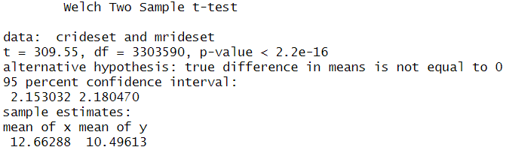
The Data
What steps have you taken to ensure that your data is clean? How can you verify that your data is clean and ready to analyze?
Each column (field) of the data set was inspected and evaluated for consistency and completeness and all identified anomalies were removed. Since there is no standard value to measure against, accuracy was not evaluated.
Since I also evaluated the entire population of the dataset and not a sample, I did not perform a test for confidence interval or margin of error. However, a t-test was performed on the final data set of ride lengths of casual and member riders to test for statistical significance. p = 0.00000000000000022. Therefore, I rejected the null hypothesis and accepted the alternative. The data sets were statistically different from each other. This means that casual riders did have statistically different ride lengths than member riders.

Slide 61
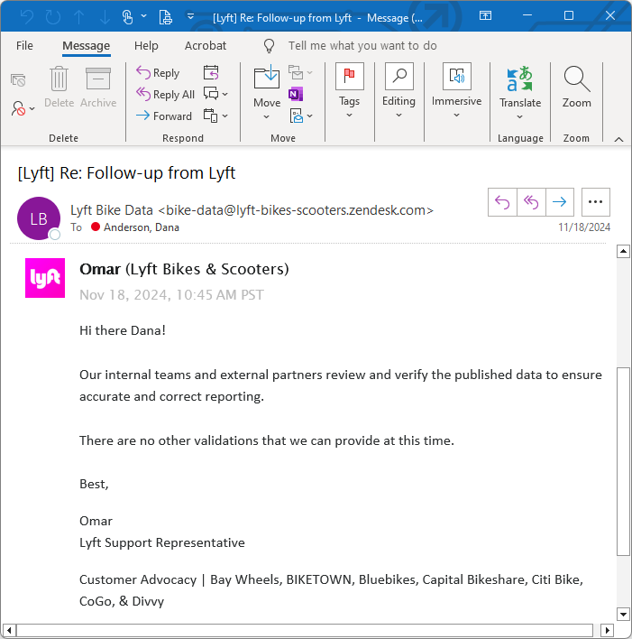
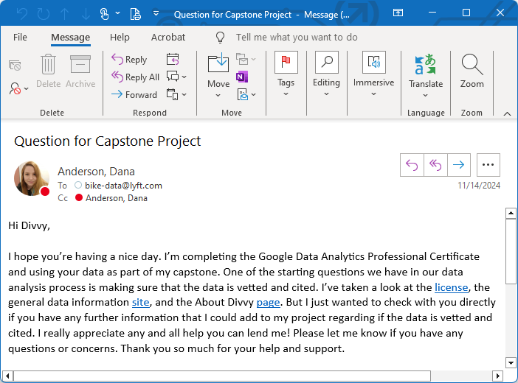
Lyft correspondence

Slide 62
Sources and Tools
Data was sourced from Divvy and downloaded as CSV files.
Analysis was performed using R language in RStudio (desktop).
R was chosen as the selected programming language because it is one of the most common languages used for data analysis. It was also the selected language of the Google Data Analytics Professional Certificate.
RStudio (desktop) was chosen as the selected program because it is the most common program to use when performing data analysis using R, apart from the base R program. RStudio also provides a better environment and more support for learners. The desktop version was used over the web-based version because the web-based version didn’t have the capacity to analyze the large amount of data under it’s free-to-use designation.

Slide 63
Data Dictionary
ride_id (character) – 16-character identifier for each ride
rideable_type (character) – 3 options: classic_bike, electric_bike, and electric_scooter
started_at (character) – date and time of when the ride started, format YYYY-MM-DD HH:MM:SS
ended_at (character) – date and time of when the ride ended, format YYYY-MM-DD HH:MM:SS
start_station_name (character) – name of the station, 1767 different stations
start_station_id (character) – ID of the station, 1725 different IDs
end_station_name (character) – name of the station, 1780 different stations
end_station_id (character) – ID of the station, 1732 different IDs
start_lat (numerical) – the latitude coordinate of the starting location, format ##.##/-##.##
start_lng (numerical) – the longitude coordinate of the starting location, format ##.##/-##.##
end_lat (numerical) – the latitude coordinate of the ending location, format ##.##/-##.##
end_lng (numerical) – the longitude coordinate of the ending location, format ##.##/-##.##
member_casual (character) – 2 options: casual, member

Slide 64
Object Dictionary – Part 1
bikedata (octdata, sepdata, augdata, juldata, jundata, maydata, aprdata, mardata, febdata, jandata, decdata, novdata)
bdnewna
bdnew
bdfinal → ride_length_plot (problem #1), ride_type_plot (problem #5a)
ride_stats (problem #1)
dotw_stats1
dotw_stats2 → week_length_plot (problem #2a)
dotw_stats3 → week_num_plot (problem #2b)
soty_stats1
soty_stats2 → season_length_plot (problem #3a)
soty_stats3 → season_num_plot (problem #3b)
moty_stats1
moty_stats2 → month_length_plot (problem #4a)
moty_stats3 → month_num_plot (problem #4b)
type_stats1
type_stats2 → type_num_plot (problem #5b)

Slide 65
Object Dictionary – Part 2
bdfinal
casualset
crideset → casualridemode
cdayset1 → casualdaymode
cdayset2
cdotw_stats (problem #2a)
cseasonset1 → casualseasonmode
cseasonset2
csoty_stats (problem #3a)
cmonthset1 → casualmonthmode
cmonthset2
cmoty_stats (problem #4a)
ctypeset1 → casualtypemode
ctypeset2
ctype_stats (problem #5a)
top_ten_cas → top_ten_cstart (problem #6b)
top_ten_cae → top_ten_cend (problem #6b)
top_ten_cstart + top_ten_cend → top_ten_overallc (problem #6b)
bdfinal
memberset
mrideset → memberridemode
mdayset1 → memberdaymode
mdayset2
mdotw_stats (problem #2a)
mseasonset1 → memberseasonmode
mseasonset2
msoty_stats (problem #3a)
mmonthset1 → membermonthmode
mmonthset2
mmoty_stats (problem #4a)
mtypeset1 → membertypemode
mtypeset2
mtype_stats (problem #5a)
top_ten_mas → top_ten_mstart (problem #6a)
top_ten_mae → top_ten_mend (problem #6a)
top_ten_mstart + top_ten_mend → top_ten_overallm (problem #6a)

Slide 66
Data Cleaning/Transformation Documentation
Merged the 12 months of data into a single dataframe. The full data set contained 5,933,712 records.
Identified the variables. Identified general characteristics of each variable, like type, minimum value, maximum value, minimum length, and maximum length. Looked for missing, null, and NA values.
Removed the start_station_name, start_station_id, end_station_name, and end_station_id columns as they each had over 1 million blank values. I also felt that they didn’t add value to the analysis since I wasn’t looking at the location identifiers for this analysis.
Removed 7,417 rows (records) because of the NA values in the End Latitude and End Longitude variables. This accounted for 0.00125 (0.125%) of the data.
Converted the started_at column and the ended_at column into Date Time.
Calculated the trip length by subtracting the started_at column from the ended_at column and dispensed the result in a new column, ride_length. Converted the results from seconds to minutes.
Removed 258 rows (records) of start dates and end dates that were swapped, creating negative trip lengths. This accounted for 0.0000435 (0.00435%) of the data.
Removed 134,526 rows (records) where the ride length was less than 1 min (60 secs). Divvy stated that all data was screened for trips that were less than 60 seconds because of user error (riders cancelling trips, etc). This accounted for 0.0227 (2.27%) of the data.

Slide 67
Data Cleaning/Transformation Documentation
Determined what was considered an outlier (433,841 records). This accounted for 0.0728 (7.28%) of the data. Removed them.
A total of 576,042 rows (records) were removed from the original data set (5,933,712 records), which accounted for 0.0971 (9.71%) of the data. The resulting data set used for calculations was 5,357,670 records.
Calculated the days of the week for date and time each trip started and dispensed the results in a new column, dotw_start.
Calculated the month of the year for date and time each trip started and dispensed the results in a new column, moty_start.
Calculated the season of the year for date and time each trip started and dispensed the results in a new column, soty_start.

